Slide 1

The use of generative artificial intelligence in games development
Ethan Taylor
22039755
MID-POINT REVIEW

Slide 2

Agenda
Project Introduction
Project Aim
Project Objectives
Literature Review
Research Methodology
Current Developments (optional)
Development Phase Plans
Testing Phase Plans
Gantt Chart of Future Weeks
Questions

Slide 3
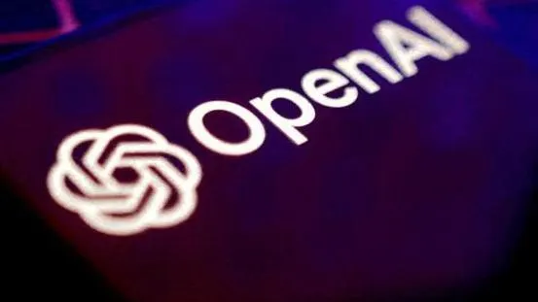

Introduction
Artificial intelligence is being used by all industries across the board and the rate at which businesses are picking up and using AI in different ways is increasing as well.
The use of generative artificial intelligence has brought new uses for AI to the games industry.
The question being “How should generative artificial intelligence be used in the development of games.”
Notes:
More efficient workflows
New AI uses
What is GAI

Slide 4
Aim & Objectives
Aim
Objectives
To see if people prefer a game to only use human made components at the cost of variation or if they would prefer developers to use generative artificial intelligence to add unique experiences.
Design two versions of the same scenario for people to experience.
Create the deigned scenarios with the focus being on the dialogue differences.
Form a conclusion supported by information gathered from the feedback questions.
Notes:
Aim
Design two scenarios (don’t go into too much detail yet)
Conclusion/hypothesis

Slide 5
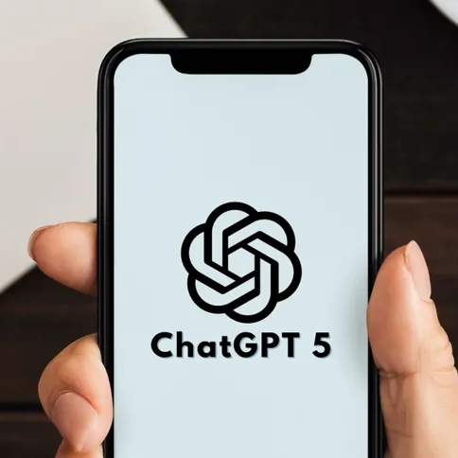


Literature Review
What is generative artificial intelligence?
How is AI/GAI used in games?
What are the benefits/concerns of AI/GAI?

Slide 6
Literature Review
What is generative artificial intelligence?
The different types of GAI.
What is AI learning.
Peñalvo, F.J.G. (1970) What do we mean by Genai? A systematic mapping of the evolution, trends, and techniques involved in Generative AI, Dialnet.
Batty, M. (2025) Sage Journals.
Feuerriegel, S. et al. (2023) Generative AI - Business & Information Systems Engineering, SpringerLink.
Li, J. et al. (2016) Arxiv.
Notes:
What is GAI
ChatGPT
Sora
Grok
Reinforced learning

Slide 7



Literature Review
How is AI/GAI used in games?
Bring NPCs to life.
Generating images/art to use in game.
Generating code to help developers.
Adaptable decision making through AI.
Mantella - bring npcs to life with AI at Skyrim special edition nexus - mods and community (2023) Nexus Mods.
Gayathri, N. (2025) Generative AI: Disruptive Technologies for Innovative Applications.
Notes:
Decision making / pathfinding
Skyrim mod - mantella
Other possibilities

Slide 8
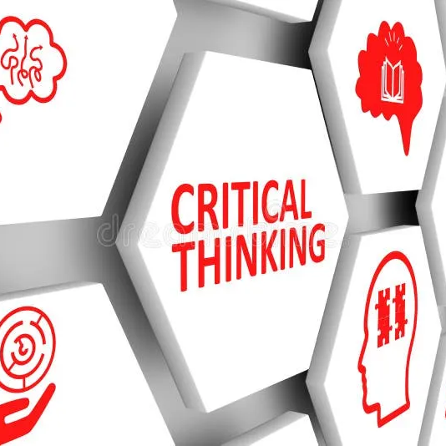

Literature Review
What are the benefits/concerns of AI/GAI?
Benefit:
Reducing stagnation in smaller elements of development.
Gayathri, N. (2025) Generative AI: Disruptive Technologies for Innovative Applications.
Concern:
The effect on people’s critical thinking.
Sadeghpour, M. (2025) Generative AI in collaborative academic report

Slide 9

Research Methodology
I will be using the design science methodology.
Research -> Artefact -> Testing
What will my artefact be?
What tests will be carried out using this artefact?
Notes:
Design science
Quick overview (go into detail on next slide)

Slide 10
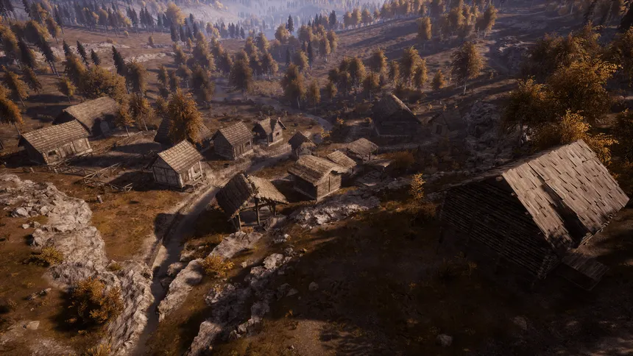
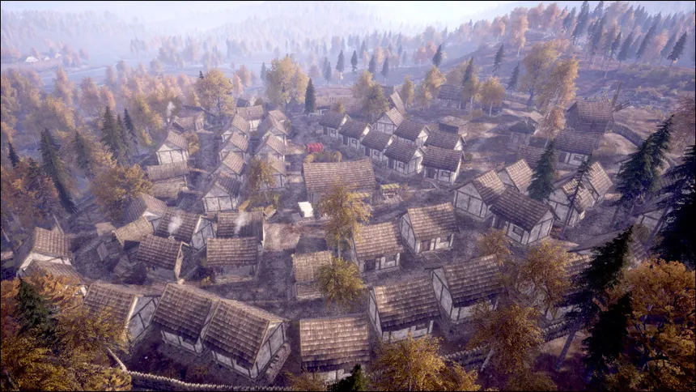
Future Developments
Two versions of the same scenario.
The first using human-made dialogue.
The second using artificially generated dialogue.
Only a couple of NPCs will have proper dialogue.
Others will consist of single lines.
The player will have a choice between two dialogue options.
The scenarios will be complete when the player completes the quest.
The player will then be asked to fill out a feedback form.
The assets for the scenarios will be sourced not made (except for the dialogue)
The scenarios will be in first person.

Slide 11
Timeline Overview
October 2024
Project pitch.
Initial meetings.
Ethics.
Begin literature review.
November 2024
Work through the literature review.
Begin to prep for the mid-point viva.
December 2024
Move project into the development phase.
Write up initial test plan.
January 2025
February 2025
Finalise development.
Begin testing phase.
Conduct experiment.
Gather data and evaluate.
Final write up.
Artefact polish.
Submit entire project.
Begin to prep for the final viva.
March 2025
Present final Viva.
Await grade.
Finish testing
Finish development
Submit entire project
Current point in the timeline.
Final write up
Notes:
Discuss what has been done so far and what will happen from here on.

Slide 12

THANK YOU// QUESTIONS
Ethan Taylor
22039755
t039755m@student.staffs.ac.uk

